Slide 1
Recommendation System to Select a Area to Rent a House

Slide 2
Introduction
Major Populations lives in the city (across the world)
People move across the city due to various reasons (Primarily Job)
Difficult to find the best neighborhood in the unknown city
People preferences change with respect to their Age and culture

Slide 3
Data Used
Bangalore is IT hub of India, Many people come/move across Bangalore due to Job and various reasons
FourSquare API used to explore the neighborhoods in the Bangalore City

Slide 4
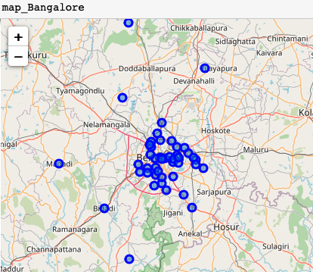
Bangalore Map with Neighborhoods

Slide 5
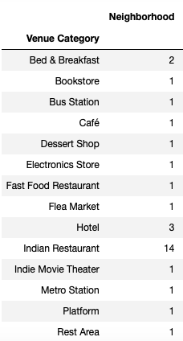
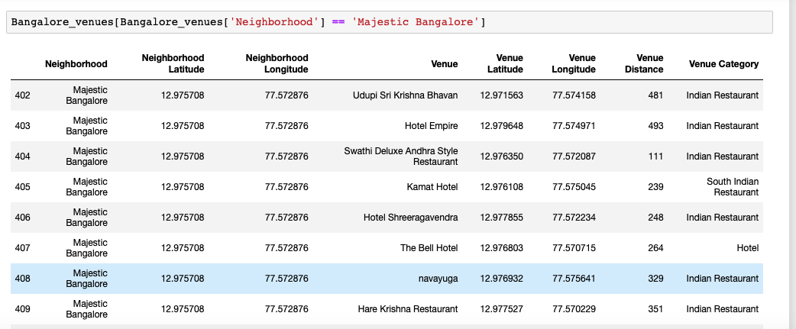
Explore Bangalore Using Foursquare API
Places around Majestic Bangalore

Slide 6
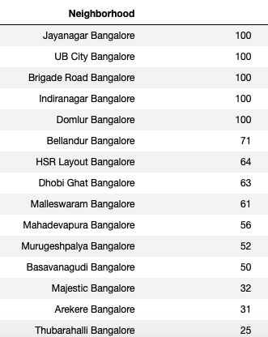
Venues in Neighborhood in Bangalore
Using Foursquare API explored all neighborhoods in Bangalore sort the results based more venues available in the neighborhood

Slide 7
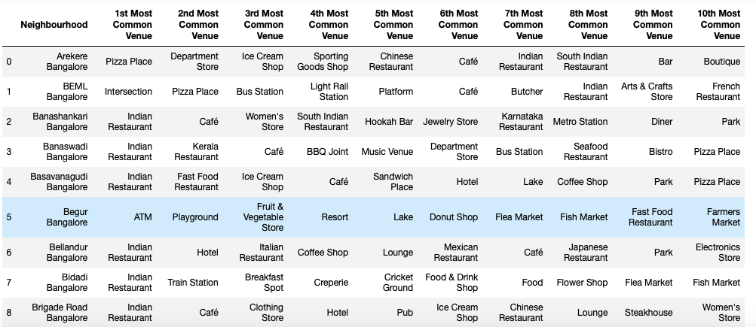
Common Venues across the Bangalore

Slide 8
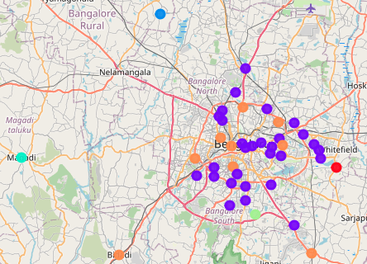
Clustering ( using K-Means Algorithm)

Slide 9
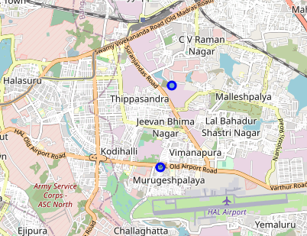
Case Study1: Recommend a place based on the inputs
Recommend a place between MugugeshPalaya or Tippachandra based on the schools and Metro stations near By

Slide 10
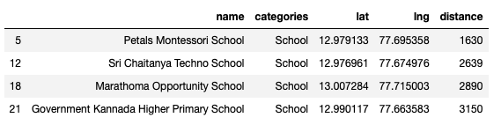
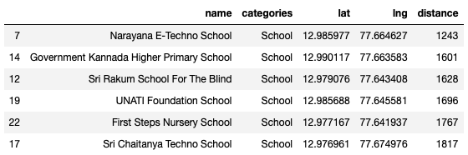
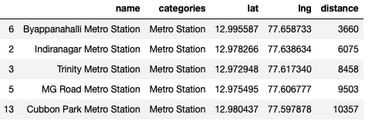
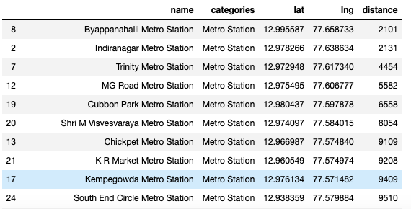
MurugeshPalaya
Case Study1: Comparison of Places
Tippachandra recommended due to schools and Metro stations are very close By
Tippachandra

Slide 11
Conclusion
Foursquare API successfully used to explore the neighborhoods in Bangalore
Using K-Means clustering algorithm to cluster the neighborhoods
Case study to recommend the place based on the user need

